Slide 1
Android Development Workshop
Over 80 percent of smartphones run android worldwide

Slide 2
Association for Computing Machinery ‘ACM’
West Virginia University Student Chapter

Slide 3
What is ACM ?
Association for Computing Machinery
Nobel Prize of Computing
Discount for ACM Conferences
ACM Digital Library

Slide 4
Current Chapter Officers
Di Pang, Chair
Zoe Delilo, Vice-Chair
Catherine Hines, Secretary
MJ Ahmad, Treasurer
Rebekah Kambara, Web Master
Dr. Katerina Goseva-Popstojanova, Faculty Advisor

Slide 5
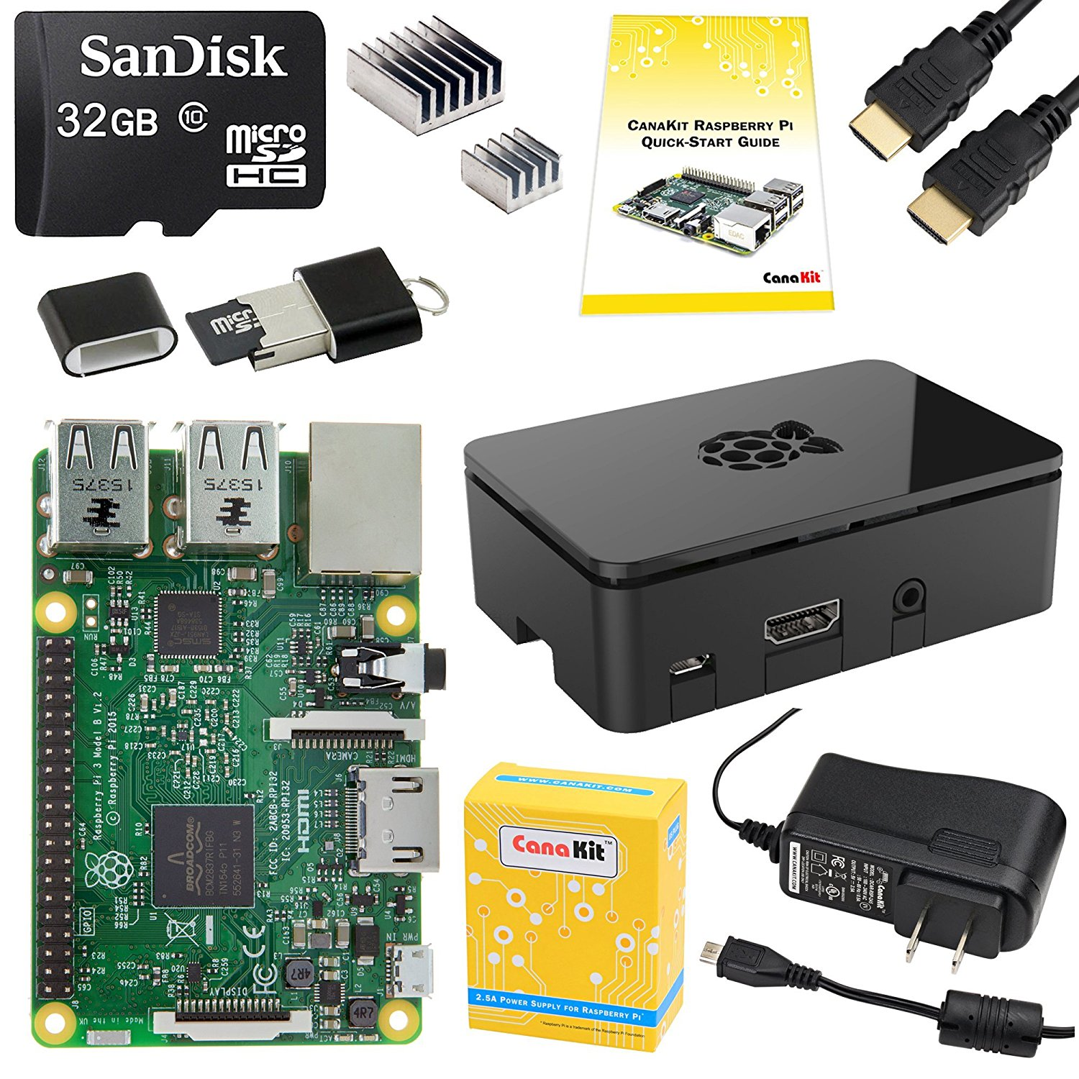
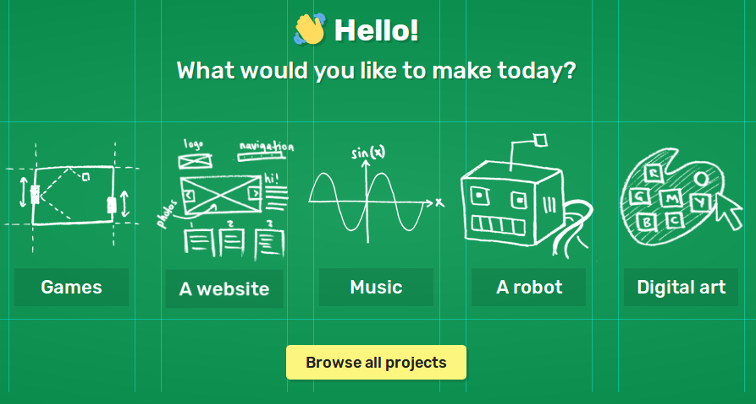
Upcoming Events
https://projects.raspberrypi.org/en/
Raspberry Pi Projects

Slide 6
Machine Learning Seminar

Slide 7
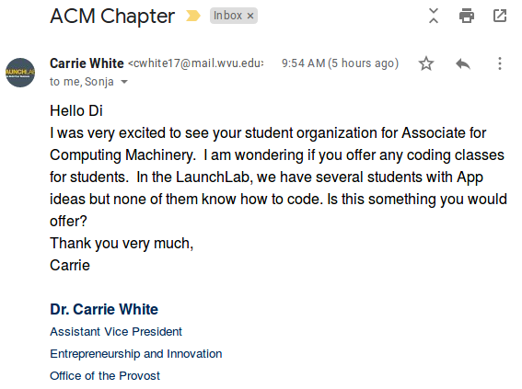
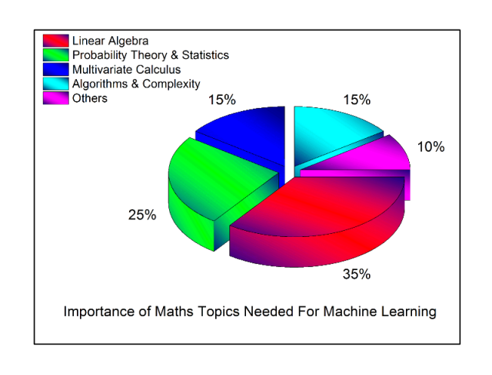
Events Suggested by Chapter Members
More Android App Development workshop?
Mathematics needed for Machine Learning/Deep Learning/Artificial Intelligence ?
Learning how to learn (online tutorials/courses/ books, etc)?

Slide 8
Contact Info
Email: acmwvu@gmail.com
Website: https://acm.orgs.wvu.edu/
Membership: https://acm.orgs.wvu.edu/membership
Choose Student membership ($19 / year)
Send us your ACM student membership number and contact info
We’ll add you to our chapter’s Email list

Slide 9
Why Android?

Slide 10
Free
Open Source
Easy to Develop
Notes:
https://www.themobileindian.com/news/why-is-android-so-popular-899

Slide 11
Developing our First App

Slide 12
Targeted Android Devices

Slide 13
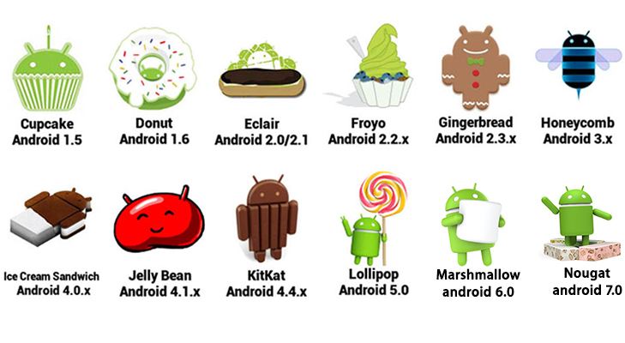
Targeted Android Devices
Tells you how many devices your application will target
The lower the version you allow, the more devices you can target!
Trade off?
You will have not have access to any features that came with newer versions....
Notes:
Examples:
Kitkat 4.4
Has Google Now integrated integrated to always listen for phrase “OK Google”
Full Screen Immersion
Enhancements in NFC -> Connectionless file transfer

Slide 14
Hello World!
app
Application boot instructions
Manifest
java
Source Code
Resources (logos, layouts, styles, etc…)
res

Slide 15
Android Resources ‘res’
res
This folder is where all app related resources will be held
Images/logos, styles, colors, etc.. Will all be placed within one of the folders in the resource folder.
drawable
layout
values

Slide 16
Android Resources ‘java’
java
company.app
Java is the primary programming language used in android development.
These folders will hold the source code for your project and tests
company.app (androidTest)
Company.app (test)

Slide 17
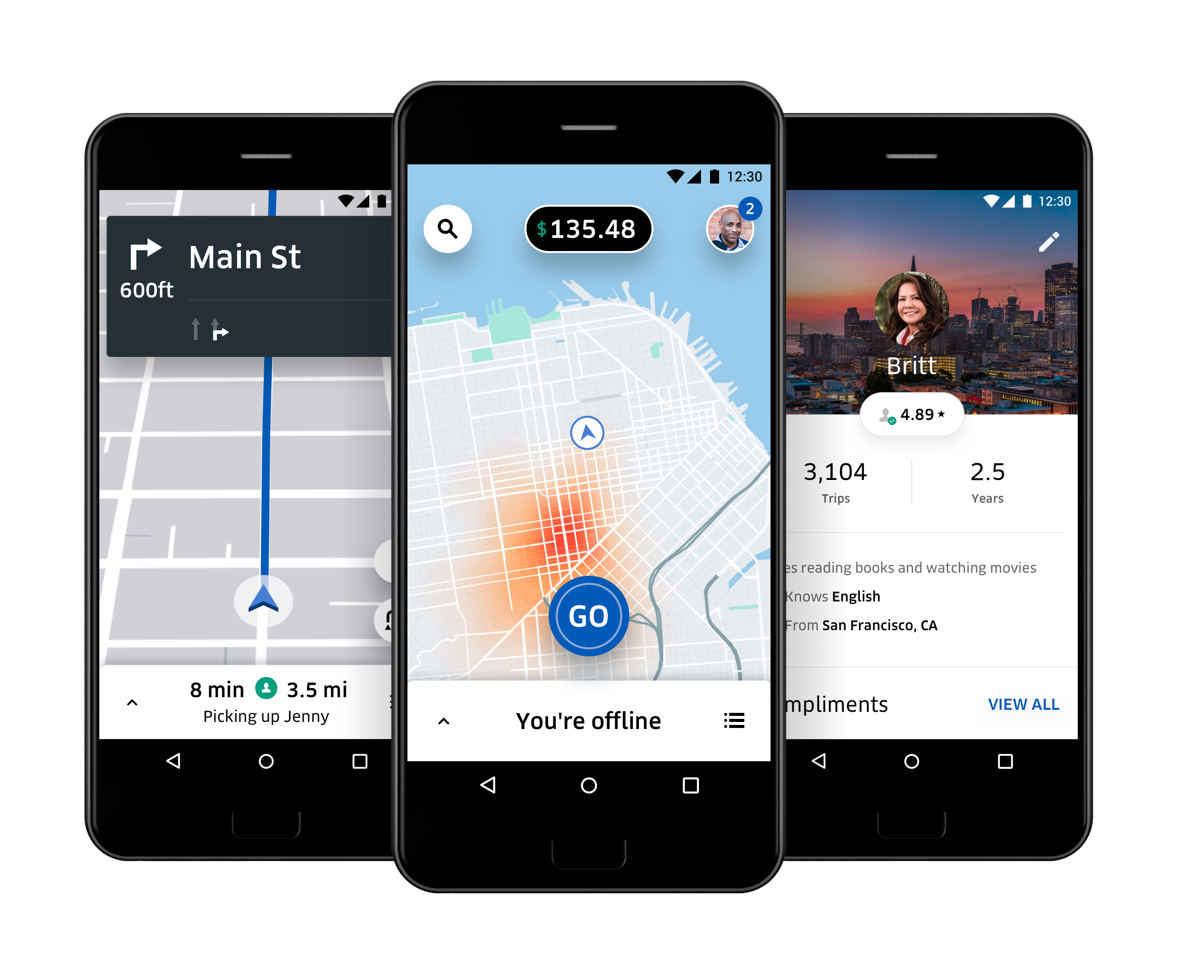
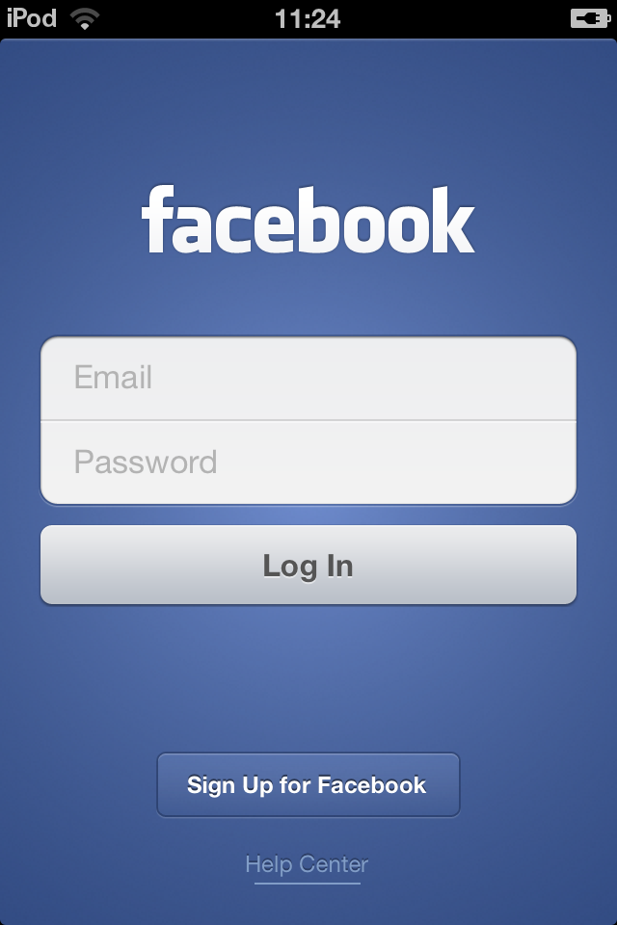
Activity

Slide 18
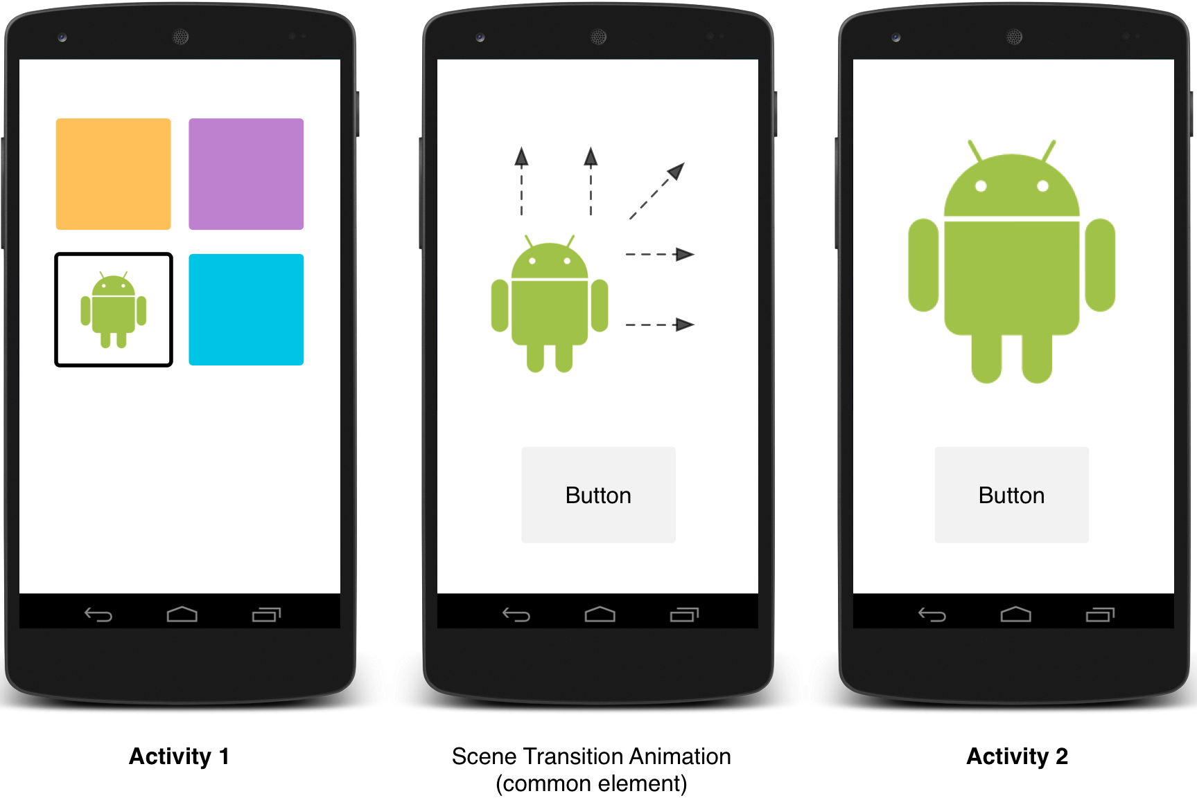
Activity
Think of it as a page!
It will be the visual component of your application backed with the functionality you program into each component on your page.

Slide 19
Layouts
Layouts help you organize the components of your page.
The first thing you set on your activity will be the layout for the page.
Linear
Relative
Grid

Slide 20
Publishing our App....

